Slide 1
CS F415: Data Mining
Yashvardhan Sharma

Slide 2
Today’s Outline
Data Preprocessing
  How to handle Noisy Data
  Data Preprocessing Techniques
  Dimensionality Reduction

Slide 3
How to Handle Noisy Data?
Binning method:
  first sort data and partition into (equi-depth) bins
  then one can smooth by bin means, smooth by bin median, smooth by bin boundaries, etc.
Clustering
  detect and remove outliers
Combined computer and human inspection
  detect suspicious values and check by human (e.g., deal with possible outliers)
Regression
  smooth by fitting the data into regression functions

Slide 4
Simple Discretization Methods: Binning
Equal-width (distance) partitioning:
  Divides the range into N intervals of equal size: uniform grid
  if A and B are the lowest and highest values of the attribute, the width of intervals will be: W = (B –A)/N.
  The most straightforward, but outliers may dominate presentation
  Skewed data is not handled well.
Equal-depth (frequency) partitioning:
  Divides the range into N intervals, each containing approximately same number of samples
  Good data scaling
  Managing categorical attributes can be tricky.

Slide 5
Binning Methods for Data Smoothing
Sorted data (e.g., by price)
  4, 8, 9, 15, 21, 21, 24, 25, 26, 28, 29, 34
Partition into (equi-depth) bins:
  Bin 1: 4, 8, 9, 15
  Bin 2: 21, 21, 24, 25
  Bin 3: 26, 28, 29, 34
Smoothing by bin means:
  Bin 1: 9, 9, 9, 9
  Bin 2: 23, 23, 23, 23
  Bin 3: 29, 29, 29, 29
Smoothing by bin boundaries:
  Bin 1: 4, 4, 4, 15
  Bin 2: 21, 21, 25, 25
  Bin 3: 26, 26, 26, 34

Slide 6
Cluster Analysis

Slide 7
Regression
y
Y1
Y1’
y = x + 1
X1
x

Slide 8
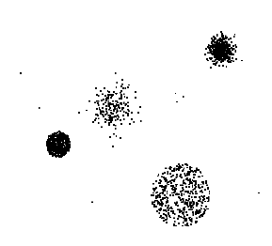
Outliers
Outliers are data objects with characteristics that are considerably different than most of the other data objects in the data set

Slide 9
Duplicate Data
Data set may include data objects that are duplicates, or almost duplicates, of one another
  Major issue when merging data from heterogeneous sources
Examples:
  Same person with multiple email addresses
Data cleaning
  Process of dealing with duplicate data issues

Slide 10
Data Preprocessing
Aggregation
Sampling
Dimensionality Reduction
Feature subset selection
Feature creation
Discretization and Binarization
Attribute Transformation

Slide 11
Data Reduction Strategies
A data warehouse may store terabytes of data
  Complex data analysis/mining may take a very long time to run on the complete data set
Data reduction
  Obtain a reduced representation of the data set that is much smaller in volume but yet produce the same (or almost the same) analytical results
Data reduction strategies
  Data cube aggregation
  Dimensionality reduction — remove unimportant attributes
  Data Compression
  Discretization and concept hierarchy generation

Slide 12
Aggregation
Combining two or more attributes (or objects) into a single attribute (or object)
Purpose
  Data reduction
    Reduce the number of attributes or objects
  Change of scale
    Cities aggregated into regions, states, countries, etc
  More “stable” data
    Aggregated data tends to have less variability

Slide 13
Data Cube Aggregation
The lowest level of a data cube
  the aggregated data for an individual entity of interest
  e.g., a customer in a phone calling data warehouse.
Multiple levels of aggregation in data cubes
  Further reduce the size of data to deal with
Reference appropriate levels
  Use the smallest representation which is enough to solve the task
Queries regarding aggregated information should be answered using data cube, when possible

Slide 14
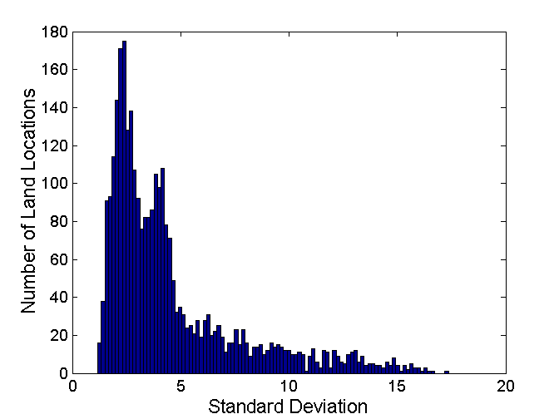
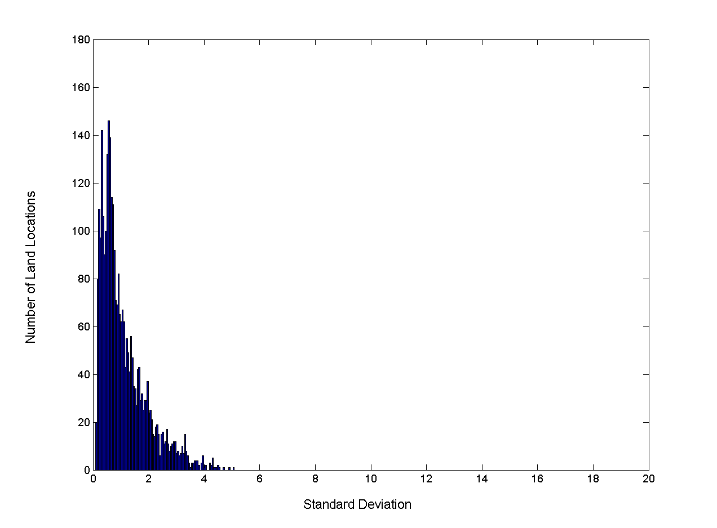
Aggregation
Variation of Precipitation in Australia
Standard Deviation of Average Monthly Precipitation
Standard Deviation of Average Yearly Precipitation

Slide 15
Sampling
Sampling is the main technique employed for data selection.
  It is often used for both the preliminary investigation of the data and the final data analysis.
Statisticians sample because obtaining the entire set of data of interest is too expensive or time consuming.
Sampling is used in data mining because processing the entire set of data of interest is too expensive or time consuming.

Slide 16
Sampling …
The key principle for effective sampling is the following:
  using a sample will work almost as well as using the entire data sets, if the sample is representative
  A sample is representative if it has approximately the same property (of interest) as the original set of data

Slide 17
Types of Sampling
Simple Random Sampling
  There is an equal probability of selecting any particular item
Sampling without replacement
  As each item is selected, it is removed from the population
Sampling with replacement
  Objects are not removed from the population as they are selected for the sample.
    In sampling with replacement, the same object can be picked up more than once
Stratified sampling
  Split the data into several partitions; then draw random samples from each partition

Slide 18
Sampling
Allow a mining algorithm to run in complexity that is potentially sub-linear to the size of the data
Choose a representative subset of the data
  Simple random sampling may have very poor performance in the presence of skew
Develop adaptive sampling methods
  Stratified sampling:
    Approximate the percentage of each class (or subpopulation of interest) in the overall database
    Used in conjunction with skewed data
Sampling may not reduce database I/Os (page at a time).

Slide 19
Sampling
SRSWOR
(simple random
sample without
replacement)
SRSWR
Raw Data

Slide 20
Sampling
Raw Data
Cluster/Stratified Sample

Slide 21

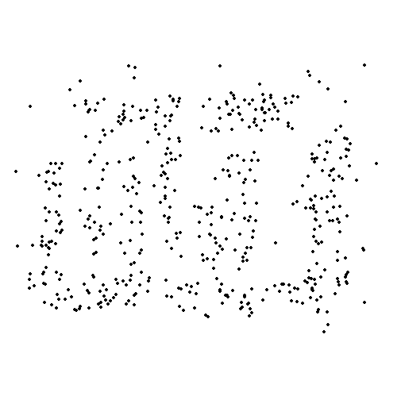
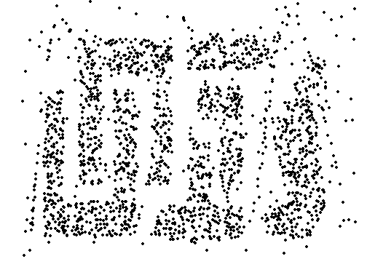
Sample Size
8000 points 2000 Points 500 Points

Slide 22
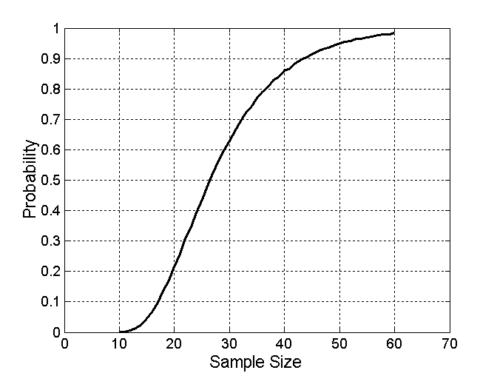

Sample Size
What sample size is necessary to get at least one object from each of 10 groups.

Slide 23
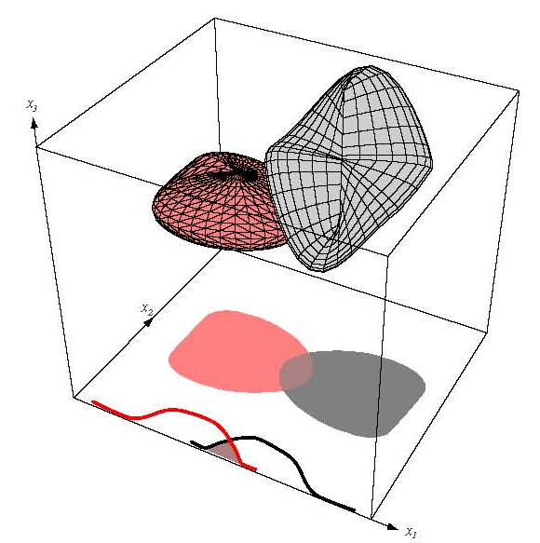
Data Dimensionality
  From a theoretical point of view, increasing the number of features should lead to better performance.
  In practice, the inclusion
  of more features leads to
  worse performance (i.e., curse
  of dimensionality).
  The number of training examples required
  increases exponentially with dimensionality.

Slide 24
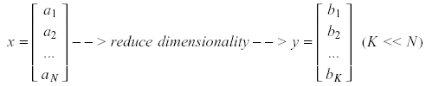
Dimensionality Reduction
Significant improvements can be achieved by first mapping the data into a lower-dimensional space.
Dimensionality can be reduced by:
  Combining features using a linear or non-linear transformations.
  Selecting a subset of features (i.e., feature selection).

Slide 25
Dimensionality Reduction
Purpose:
  Avoid curse of dimensionality
  Reduce amount of time and memory required by data mining algorithms
  Allow data to be more easily visualized
  May help to eliminate irrelevant features or reduce noise
Techniques
  Principle Component Analysis
  Singular Value Decomposition
  Others: supervised and non-linear techniques

Slide 26
Example of
Decision Tree Induction
Initial attribute set:
{A1, A2, A3, A4, A5, A6}
A4 ?
A1?
A6?
Class 1
Class 2
Class 1
Class 2
>
Reduced attribute set: {A1, A4, A6}

Slide 27
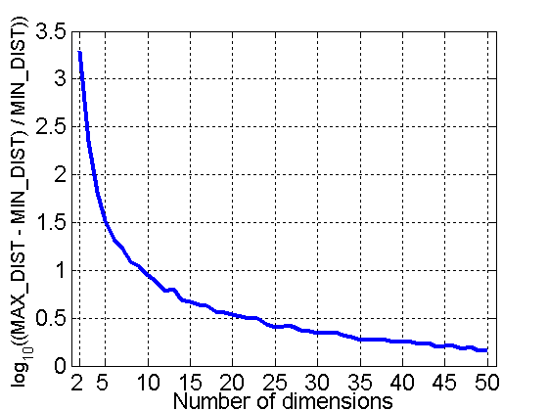
Curse of Dimensionality
When dimensionality increases, data becomes increasingly sparse in the space that it occupies
Definitions of density and distance between points, which is critical for clustering and outlier detection, become less meaningful
Randomly generate 500 points
Compute difference between max and min distance between any pair of points

Slide 28
Dimensionality Reduction (cont’d)
Linear combinations are particularly attractive because they are simple to compute and analytically tractable.
Given x ϵ R^{N}, the goal is to find an N x K matrix U such that:
y = U^{T}x ϵ R^{K} where K<<N
U^{T}

Slide 29


Dimensionality Reduction (cont’d)
Idea: represent data in terms of basis vectors in a lower dimensional space (embedded within the original space).
    (1) Higher-dimensional space representation:
    (2) Lower-dimensional sub-space representation:

Slide 30
Principal Component Analysis
Given N data vectors from k-dimensions, find c ≤ k orthogonal vectors that can be best used to represent data
  The original data set is reduced to one consisting of N data vectors on c principal components (reduced dimensions)
Each data vector is a linear combination of the c principal component vectors
Works for numeric data only
Used when the number of dimensions is large

Slide 31
Principal Component Analysis
X2
Y1
Y2
X1

Slide 32
Dimensionality Reduction: PCA
Goal is to find a projection that captures the largest amount of variation in data
x₂
e
x₁

Slide 33
Dimensionality Reduction: PCA
Find the eigenvectors of the covariance matrix
The eigenvectors define the new space
x₂
e
x₁

Slide 34
Dimensionality Reduction: PCA

Slide 35
Feature Subset Selection
Another way to reduce dimensionality of data
Redundant features
  duplicate much or all of the information contained in one or more other attributes
  Example: purchase price of a product and the amount of sales tax paid
Irrelevant features
  contain no information that is useful for the data mining task at hand
  Example: students' ID is often irrelevant to the task of predicting students' GPA

Slide 36
Feature Subset Selection
Techniques:
  Brute-force approach:
    Try all possible feature subsets as input to data mining algorithm
  Embedded approaches:
    Feature selection occurs naturally as part of the data mining algorithm
  Filter approaches:
    Features are selected before data mining algorithm is run
  Wrapper approaches:
    Use the data mining algorithm as a black box to find best subset of attributes

Slide 37
Feature Subset Selection Process

Slide 38
Feature Creation
Create new attributes that can capture the important information in a data set much more efficiently than the original attributes
Three general methodologies:
  Feature Extraction
    domain-specific
  Mapping Data to New Space
  Feature Construction
    combining features

Slide 40
Dimensionality Reduction
Feature selection (i.e., attribute subset selection):
  Select a minimum set of features such that the probability distribution of different classes given the values for those features is as close as possible to the original distribution given the values of all features
  reduce # of patterns in the patterns, easier to understand
Heuristic methods (due to exponential # of choices):
  step-wise forward selection
  step-wise backward elimination
  combining forward selection and backward elimination
  decision-tree induction

Slide 41
Heuristic Feature Selection Methods
There are 2^{d} possible sub-features of d features
Several heuristic feature selection methods:
  Best single features under the feature independence assumption: choose by significance tests.
  Best step-wise feature selection:
    The best single-feature is picked first
    Then next best feature condition to the first, ...
  Step-wise feature elimination:
    Repeatedly eliminate the worst feature
  Best combined feature selection and elimination:
  Optimal branch and bound:
    Use feature elimination and backtracking

Slide 42
Data Integration
Data integration:
  combines data from multiple sources into a coherent store
Schema integration
  integrate metadata from different sources
  Entity identification problem: identify real world entities from multiple data sources, e.g., A.cust-id ≡ B.cust-#
Detecting and resolving data value conflicts
  for the same real world entity, attribute values from different sources are different
  possible reasons: different representations, different scales, e.g., metric vs. British units

Slide 43
Handling Redundancy in Data Integration
Redundant data occur often when integration of multiple databases
  The same attribute may have different names in different databases
  One attribute may be a “derived” attribute in another table, e.g., annual revenue
Redundant data may be able to be detected by correlational analysis
Careful integration of the data from multiple sources may help reduce/avoid redundancies and inconsistencies and improve mining speed and quality

Slide 44
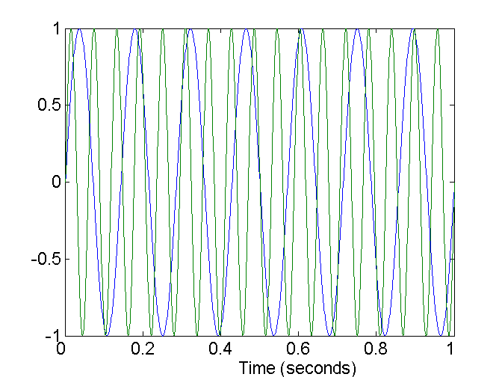
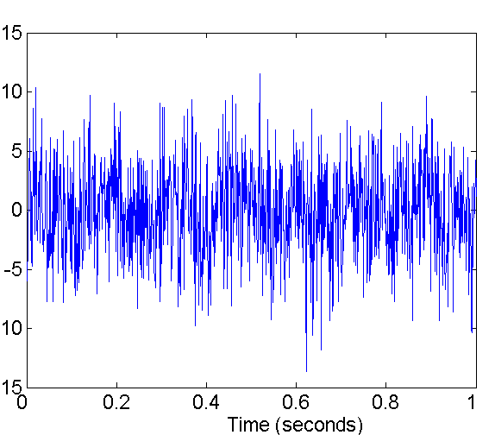
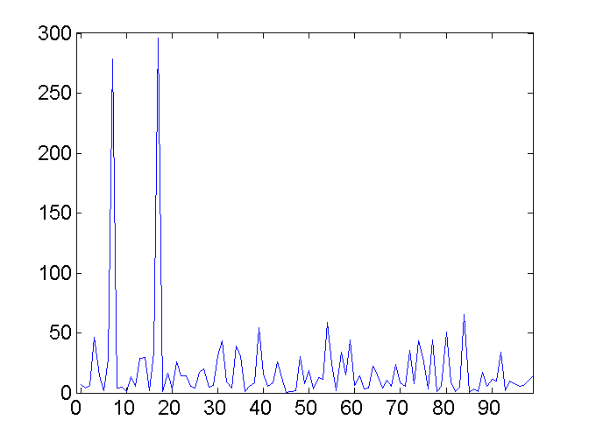
Mapping Data to a New Space
Fourier transform
Wavelet transform
Two Sine Waves
Two Sine Waves + Noise
Frequency

Slide 45
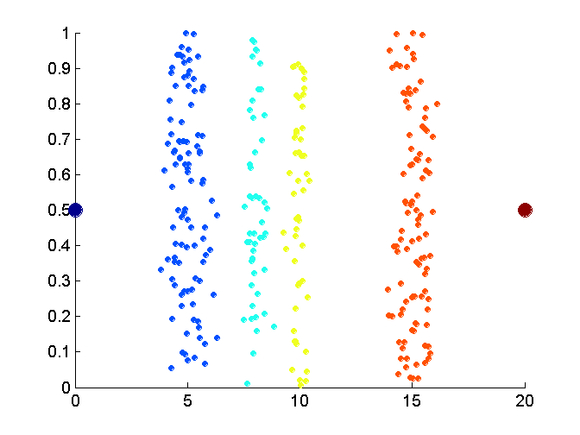
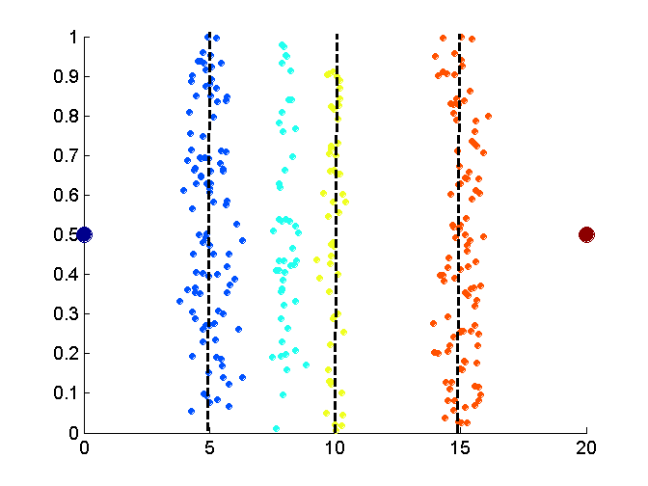
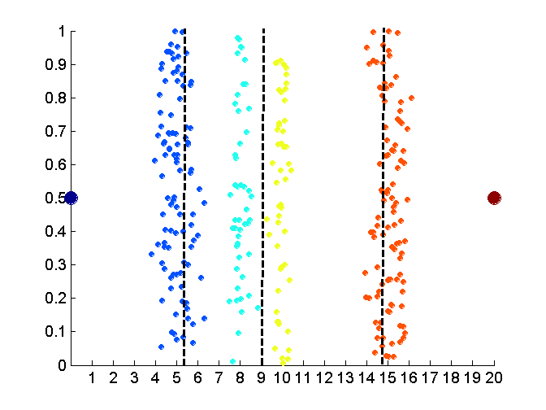
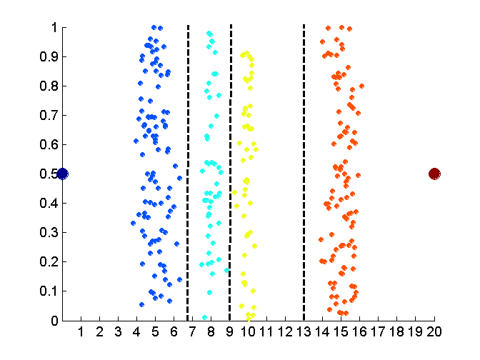
Discretization Without Using Class Labels
Data
Equal interval width
Equal frequency
K-means

